Slide 1
Final Project Presentation
By Jun & Candice

Slide 2
Motivation
Topic: Typical impression and others’ perception on the selected MBTI types, ENTJ and INTJ.
Common interest in developing a further understanding of our own MBTI types.

Slide 3
Research Questions
What are the most typical impression/description associated with ENTJ and INTJ, are they consistent with the description from authority websites?
Which MBTI type receives more positive feedback during human interaction, ENTJ or INTJ?

Slide 4
Data
Original: The MBTI-Types & Enneagram Texts dataset
Secondary data source from Kaggle
Primarily collected from web-scraping the Reddit community.
Cleaning
Extract the content with unrelated labels and forum, i.e. Romance
Extract MBTI forums beside the targeted types, i.e. ENFP - Inspirer

Slide 5
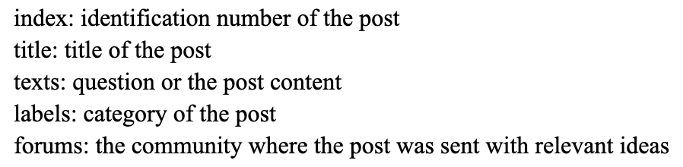
Data cont.
Our own version: data_INTJ and data_ENTJ
Consists of 5 columns
291 rows for data_INTJ & 49 rows for data_ENTJ; 340 rows in total.

Slide 6
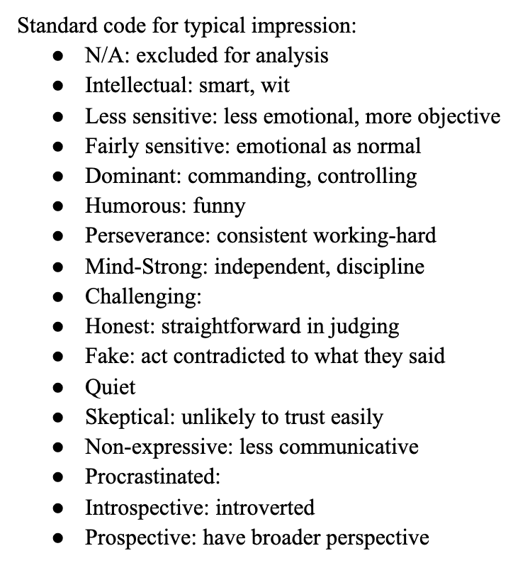
Research Method
Open-coding analysis
Assign a sentiment score (1, 0, -1; positive, neutral, negative accordingly) and a typical impression for each text.
Adjusted until Cohen's kappa value reaches over 0.80

Slide 7
Research Method cont.
Sentiment analysis
Using Python (import nltk & babypandas)
Serve as a sanity check that whether the result of the open-coding analysis is consistent.

Slide 8
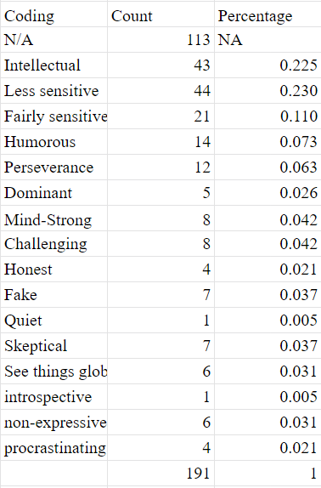
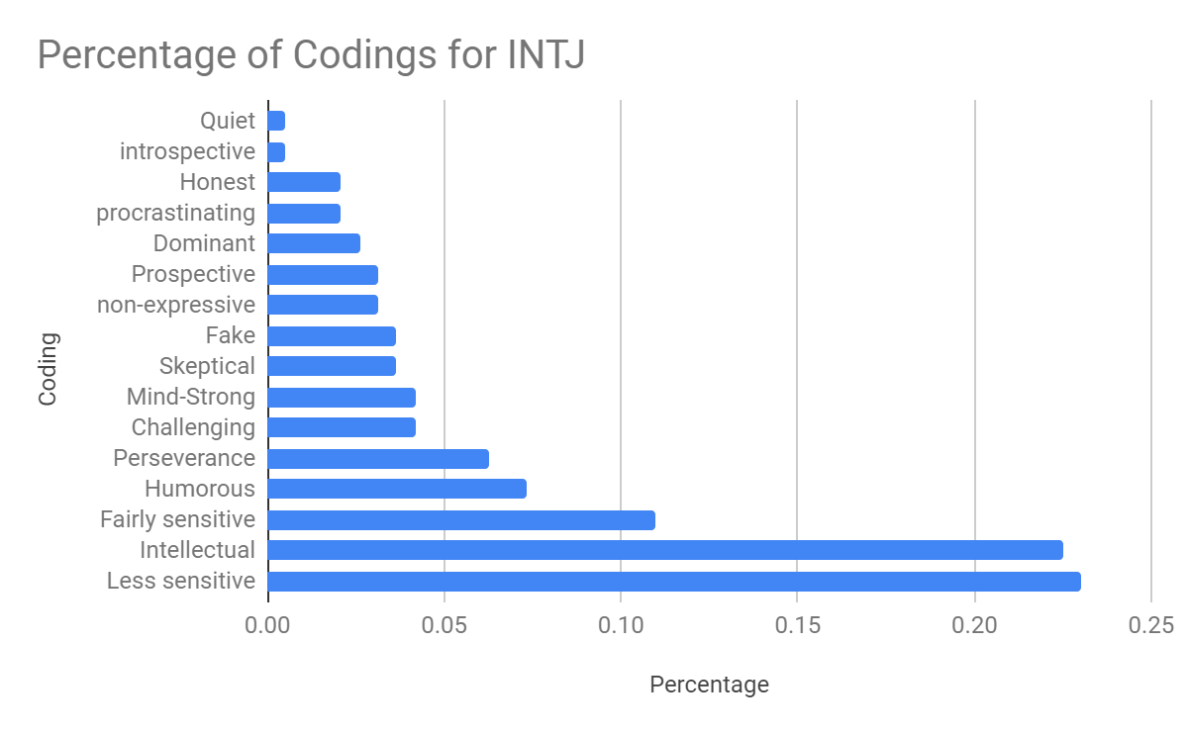
Result (INTJ)

Slide 9
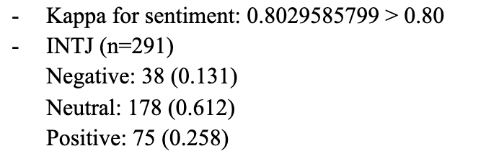
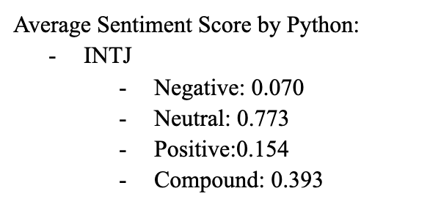
Result (INTJ) cont.

Slide 10
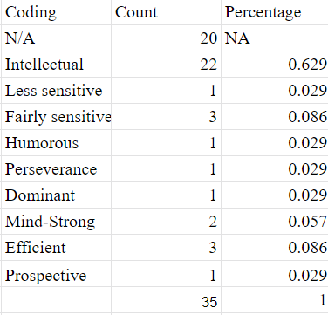
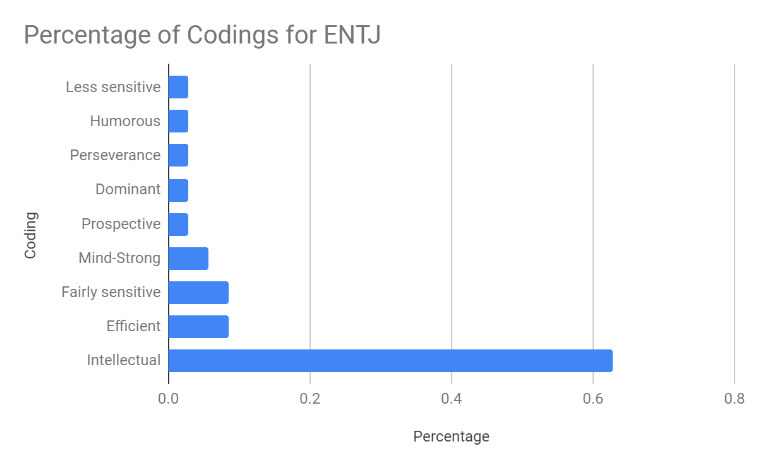
Result (ENTJ)

Slide 11
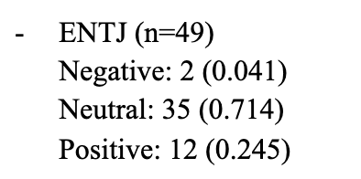
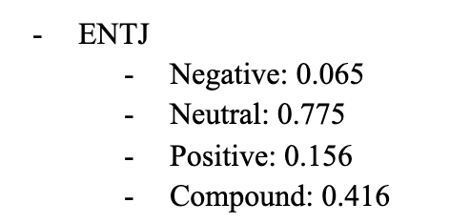
Open-Coding: NLP:

Slide 12
Conclusion & Implication
INTJ receives more positive feedback in open-coding analysis yet ENTJ receives more positive feedback using NLP approach.
In both approaches, ENTJ receives less negative feedback from their interaction with others than INTJ does.
In both approaches, people tend to feel neutral when interacting with INTJ and ENTJ despite what their own MBTI types are, implying that most people recognize, accept, and even enjoy the differences between people.
Both INTJ and ENTJ tend to be recognized as intellectual, which is consistent with the description of “T” (Thinking).
There is a much larger sample size for INTJ than ENTJ.
Notes:
Note on last point: One potential reason might be that the extrovert would focus on more in-person interaction while an introvert tends to participate more on online conversations.

Slide 13
Thank you!

